Slide 1
Week 12
Store procedures – Maziar Shajari
(Latest Revision Date Dec 2020)

Slide 2

A ‘VIEW’ Review!
https://www.youtube.com/watch?v=WQlksohMtsY&t=82s

Slide 3
SQL Stored Procedures for SQL Server
A stored procedure is a prepared SQL code that you can save, so the code can be reused over and over again.
So if you have an SQL query that you write over and over again, save it as a stored procedure, and then just call it to execute it.
You can also pass parameters to a stored procedure, so that the stored procedure can act based on the parameter value(s) that is passed.
Advantages:
1- Reduced network traffic. (Why?)
2- Code Reusability.
Notes:
Reduced network traffic
Code is stored centrally on the server, instead of being transmitted over the network

Slide 4
Stored Procedure Syntax
CREATE PROCEDURE [Proc] Sample_Procedure
AS
sql_statement
GO;
Execute a Stored Procedure:
EXEC [EXECUTE] Sample_Procedure;
Or you can simply write the name of SP and click the Execute button.
Or you can use SSMS and execute the SP

Slide 5
Simple SP Example
1- Use a SELECT query to see what is stored in Sales.Store table.
(USE AdventureWorks2014).
Select *
from AdventureWorks2014.Sales.Store
2- We only need to get four columns as below sorted by their name.
Select BusinessEntityID,Name,SalesPersonID, ModifiedDate
from AdventureWorks2014.Sales.Store
order by name
CREATE PROCEDURE Sales1
AS
SELECT BusinessEntityID, Name, SalesPersonID, ModifiedDate
FROM AdventureWorks2014.Sales.Store
ORDER BY name
GO
EXEC Sales1;

Slide 6
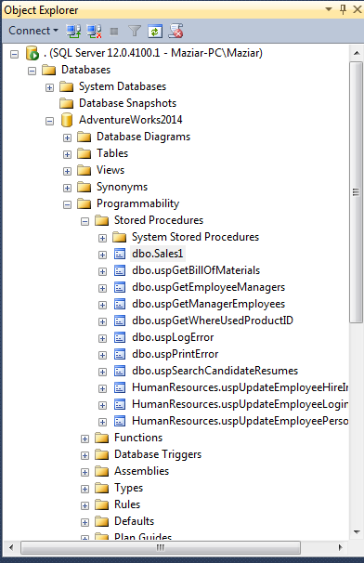
Storage place in SSMS

Slide 7
In-Class excercise
Create a SP to Update all ModifiedDate in AdventureWorks2014.Sales.Store to current date.
CREATE PROCEDURE SalesUpdatedate
AS
UPDATE AdventureWorks2014.Sales.Store
SET ModifiedDate = GETDATE()
GO
EXEC SalesUpdatedate
EXEC Sales1
Go
CREATE PROCEDURE SalesUpdatedate1
AS
Begin
SET NOCOUNT ON; --(will be explain soon)
UPDATE AdventureWorks2014.Sales.Store
SET ModifiedDate = GETDATE()
EXEC Sales1
End
GO
EXEC SalesUpdatedate1

Slide 8
Stored Procedure With One Parameter
The following SQL statement creates a stored procedure that
selects SalePersonID = 275:
CREATE PROCEDURE Sales2 @SalePersonID int
AS
Select BusinessEntityID,Name,SalesPersonID, ModifiedDate
FROM Sales.Store
WHERE SalesPersonID = @SalePersonID
GO
Parameter
EXEC Sales2 @SalePersonID = 275;
GO

Slide 9
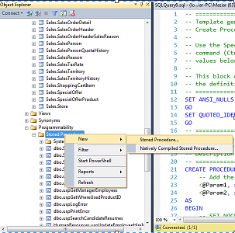
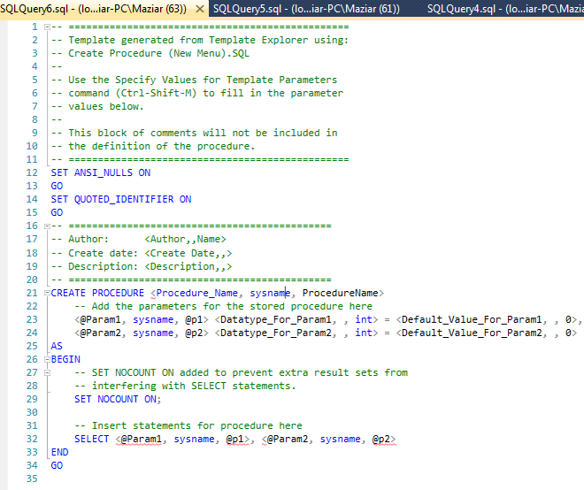
Create SP Using SSMS
Object Explorer → Programmability
→ Stored procedure → Right Click
→ New → Stored procedure
You can see it better in the next slide

Slide 11



SET NOCOUNT ON
Use the SET NOCOUNT ON statement as the first statement in the body of the procedure.
Place it just after the AS keyword. This turns off messages that SQL Server sends back to the client after any SELECT, INSERT, UPDATE, MERGE, and DELETE statements are executed.
Overall performance of the database and application is improved by eliminating this unnecessary network overhead.

Slide 12
Returning more than one result set
CREATE PROCEDURE dbo.uspMultipleResults
AS
SELECT TOP(10) BusinessEntityID, Lastname, FirstName
FROM Person.Person;
SELECT TOP(10) CustomerID, AccountNumber
FROM Sales.Customer;
GO
EXEC uspMultipleResults

Slide 13
Some helpful commands
sp_helptext uspMultipleResults
Use it to see the SP text
This is a system store procedure
Alter procedure uspMultipleResults
-- The changed query
Drop procedure uspMultipleResults
WITH ENCRYPTION

Slide 14
Using OUTPUT parameters
SELECT TOP 1000 [SalesOrderID]
,[SalesOrderDetailID]
,[OrderQty]
,[ProductID]
,[UnitPrice]
,[ModifiedDate]
FROM [AdventureWorks2014].[Sales].[SalesOrderDetail]
CREATE PROCEDURE SPSalesOrder1
@UnitP int,
@Av1 int output
AS
Begin
Select @Av1 = AVG (UnitPrice)
from Sales.SalesOrderDetail
WHERE UnitPrice >= @UnitP
END
Go
declare @Av1 int
Execute SPSalesOrder1 2000, @Av1 output
Print @AV1
GO

Slide 15
Assignment (further study)
Use the adventureWork2014.
Design a Trigger for the DELETE command in Sales.Store table (Trigger name is CheckStoreDelete).
Inside the trigger call a Store Procedure. (SP name is Store2Delete).
In the Store2Delete,
1- Check if there is a StoreDBackup table in your database. If there is not, create a table with BusinessEntityID, Name, SalesPersonID, ModifiedDate, Deleted_date columns. Datatypes must be same as the Sales.Store table in AdventureWork2014.
2- After deleting a row in the table, all the row’s data have to be inserted in the Backup table. The deleted_date column have to be filled with the current date.

Slide 16
Check the table existence in the database You need this for the assignment
User Define
IF object_id (‘ Your object name or table name’, ‘U’) is not null
Statement(s) …
ELSE
Statement(s) …
If object_id('MyTable','U') is not null
Print ('Present')
Else
Print ('Not Present')

